Slide 1
Screen Time and Cardiovascular Health in Youth
November 21, 2025
Robert Solomon, MD
Notes:
NOTES

Slide 2
There are no conflicts of interest to disclose.

Slide 3
Introduction
Statistics
Science
Intervention
Conclusion

Slide 4
Introduction
Modern day advancements in technology have been greatly impactful for humanity
Definition
  Different types
    Academic, Recreational, Passive, Interactive
  Devices
    Phone, Laptop, Tablet, TV screen, etc
Notes:
Continuous advancements in technology have forever changed all aspects of society across the globe, especially in terms of how we interact with one another and learn. The increased availability of screen technology, along with a generational shift in our relationship with this technology in the post-COVID era, has been life altering. It is not unexpected that some of these changes could impact our health.
Definition:
Although all types are sedentary activities (which therefore would mean an inordinate amount could pose harm for cardiovascular health), the recreational type is more often acknowledged as more addictive and harmful for a variety of reasons (decreased attention span for other activities, decreased time available for other activities like academic learning/physical activity/sleep; difficulty stopping, building habits/dependency that promote a cycle which serves to just promote more screen time)

Slide 5

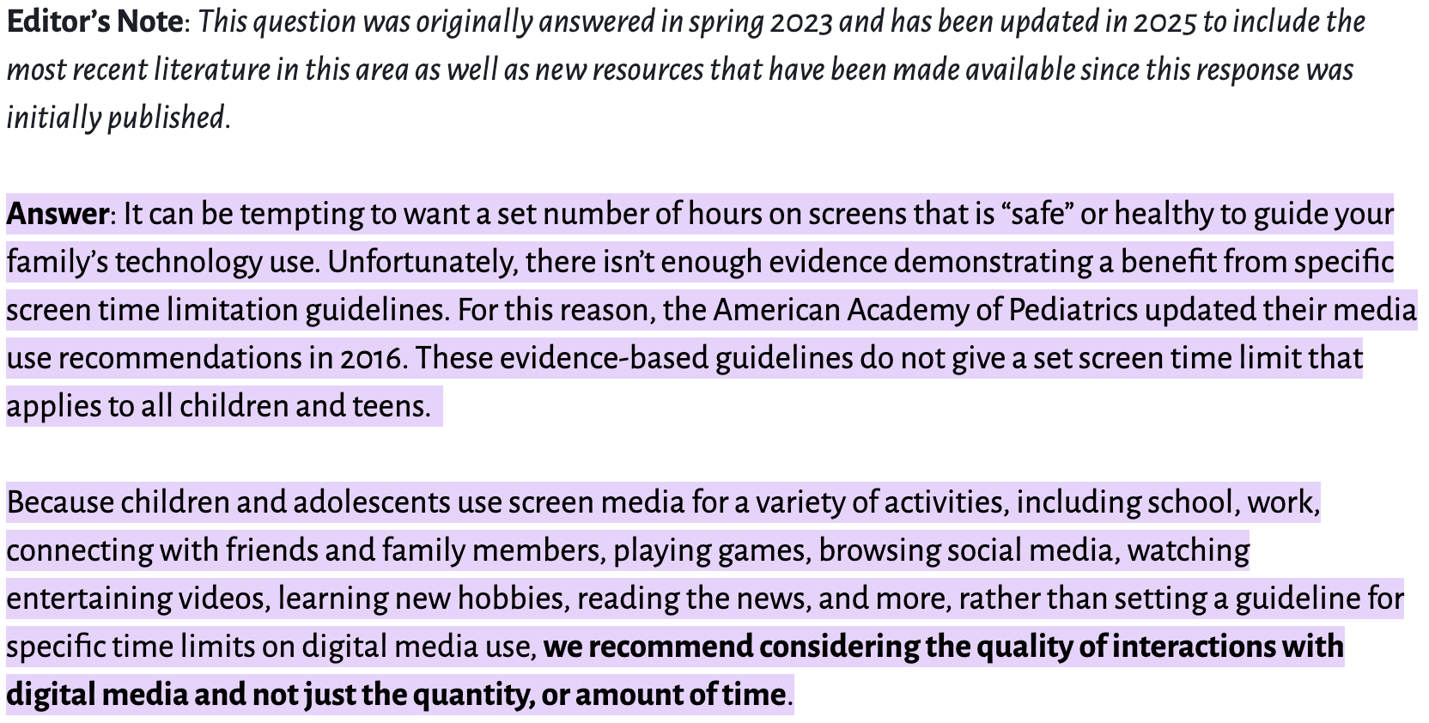
Introduction
Definition
  Time
    Moving target
      AAP focuses more on quality > quantity
      Other sources cite 2-4+ hours as “high”
      One study cited an average of 22.8 hrs/week for adolescents
Notes:
Although specifics in terms of time can vary depending on what study or organization is referenced (for instance the American Academy of Pediatrics changed recently from their 2016 guidelines which focused on time and focuses on quality of time [ex. 30 minutes interacting with family vs scrolling Instagram]) many sources generally agree 2 -4+ hours to be considered “high” on a scale of low/moderate/high

Slide 6
Introduction
Importance
  Sedentary lifestyle associated with:
    Poor health (both cardiovascular and non-cardiovascular)
    Development of poor habits
Notes:
Sedentary lifestyle from screen time not only associated with poor cardiovascular health, but in particular the types of screen time (recreational) of particular interest have been associated with mental health issues (anxiety, depression, etc)
Additionally has been attributed to the development of poor habits, which is even more worrisome as these adolescent years make up a formative time that will go on to shape their perspectives, priorities and relationships

Slide 7


Statistics
Notes:
As discussed earlier, the exact amount of recommended screen time varies based on the particular source used. But there have been studies done that give us some more data.
The NHIS (National Health Interview Survey) collected data from 2021-2023 from 12-17 year olds via a web survey with a total analytic sample of 1,952 participants. 4 or more hours was categorized as “high” screen time.

Slide 8
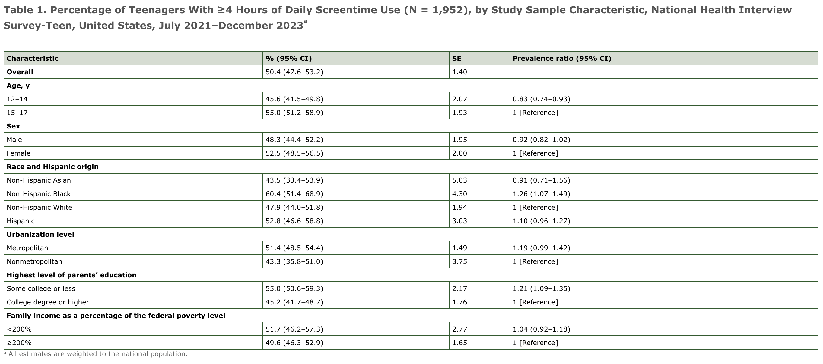
Statistics
Notes:
As you can see, a little over 50% of teens reported 4+ hours of screen time, with black teens being more likely to have 4+ hours as compared to other groups.
Numbers were also higher for females and those in metropolitan areas.

Slide 9
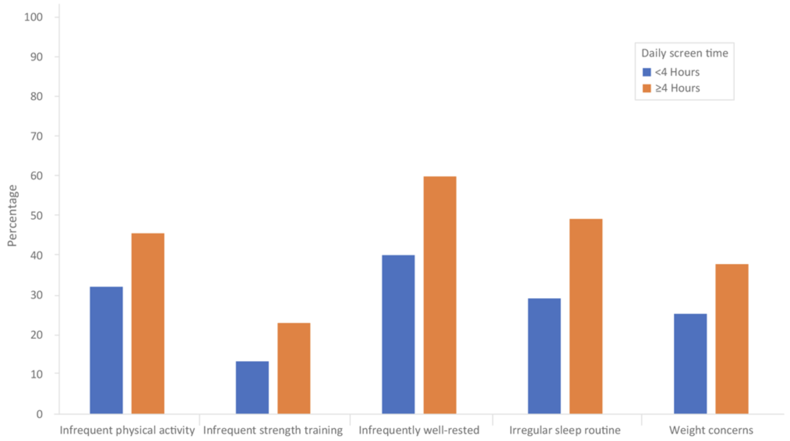
Statistics
Notes:
Increased screen time was associated with a variety of different deficiencies including infrequent physical activity, irregular sleep and weight concerns.

Slide 10
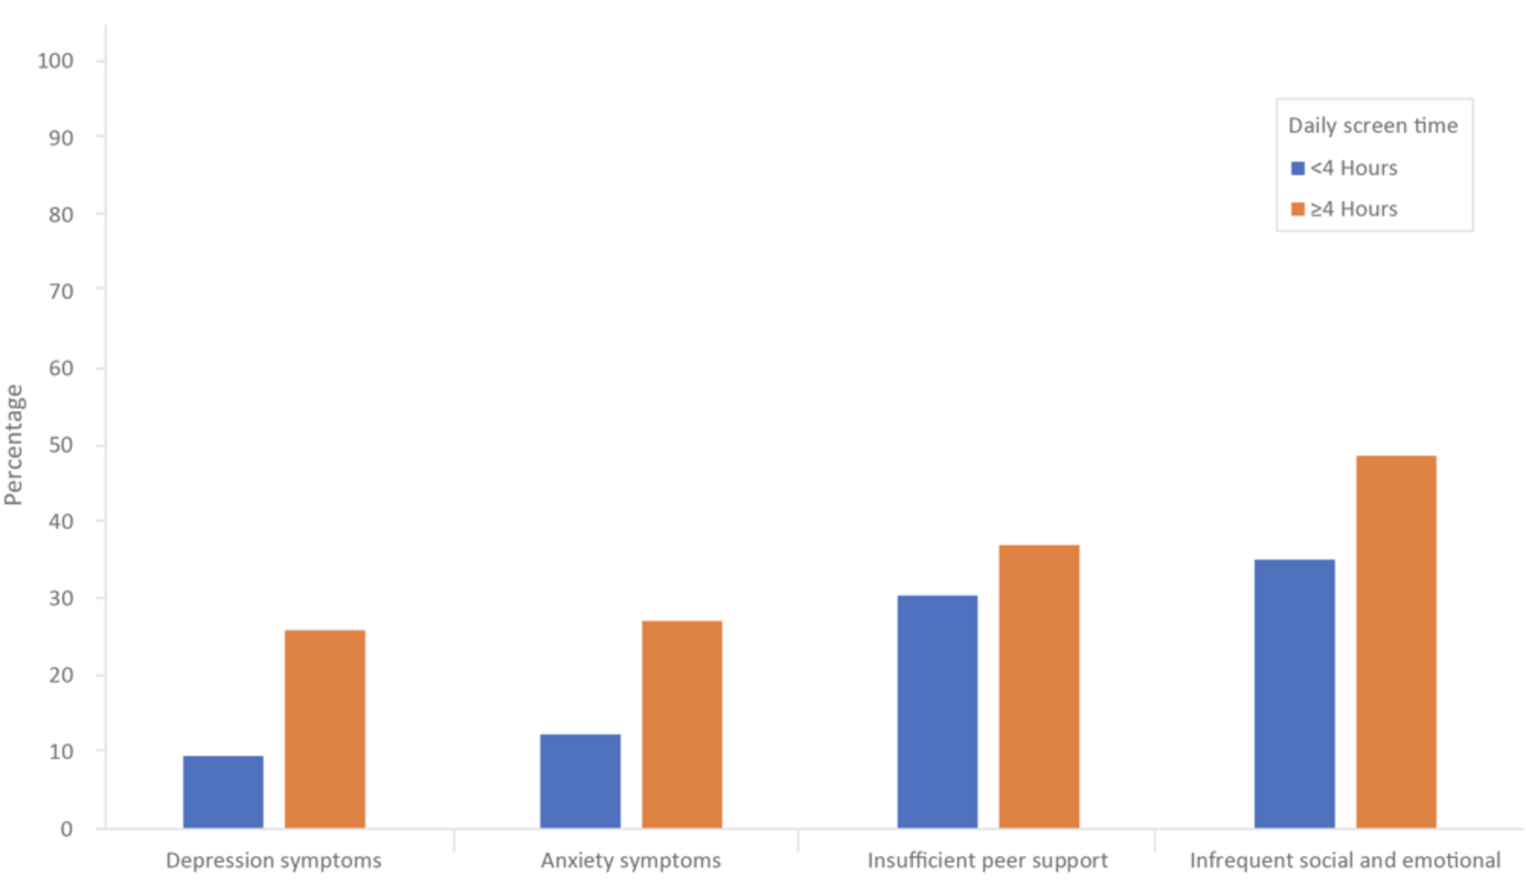
Statistics
Notes:
Increased screen time was also associated with more self reports of depression, anxiety and feelings of insufficient support

Slide 11
Statistics
Numerous studies over the past 10+ years have only corroborated the aforementioned
Notes:
Basically studies have all confirmed the basic, understandable conclusion that increased screen time poses a health risk

Slide 12
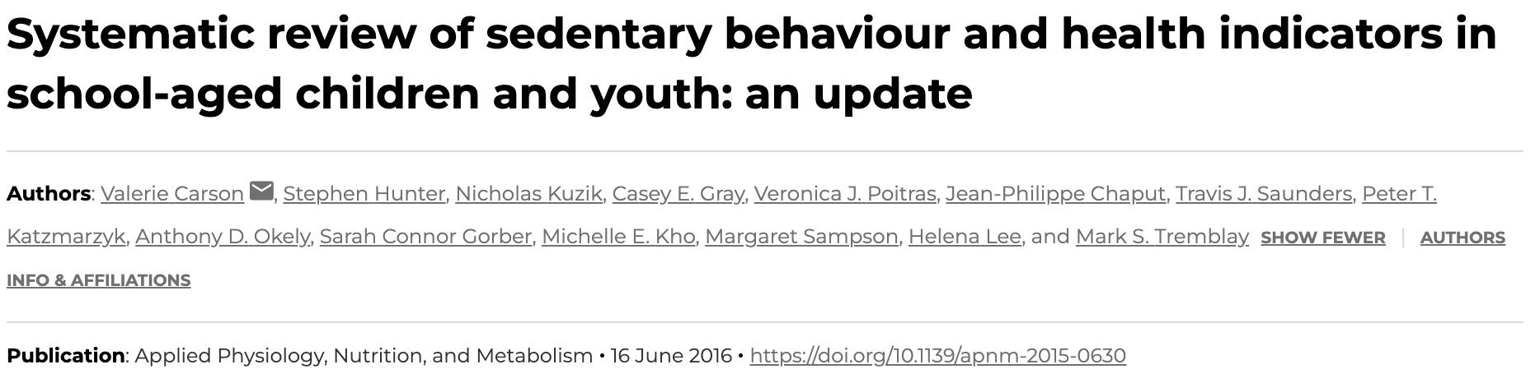
Statistics
Examined the relationship between objective and subjective sedentary behavior and health indicators in 5-17 year olds
  Higher duration/frequency of screen time associated w/ higher cardiometabolic risk scores, lower fitness, increased adiposity
Notes:
Review analyzed 235 studies over 71 countries; basically provided evidence that screen time could be a distinct cardiovascular risk factor separate from just lower exercise

Slide 13
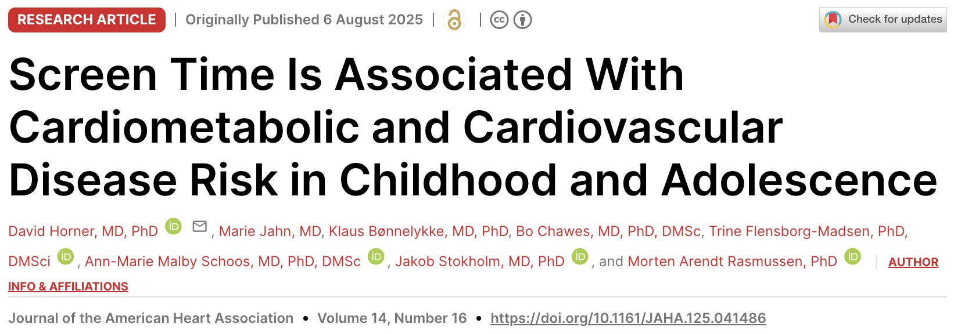
Statistics
Analyzed data in 1000+ participants
  Identified not only cardiovascular health risk, but a correlation with shorter sleep duration
Notes:
Saw screen time was associated w/ cardiometabolic and CV risk
Risk was stronger amongst those with shorter sleep duration

Slide 14
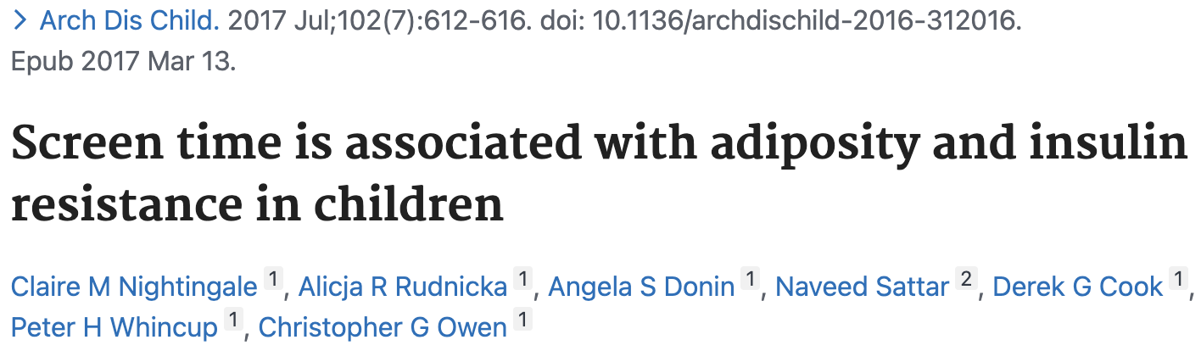
Statistics
Surveyed 4,495 children; examined association between self reported screen time and type 2 diabetes risk markers
  Found strong associations between screen time, adiposity and insulin resistance

Slide 15
Science
Biological Pathways
  Multiple pathways have been theorized to explain the increased cardiovascular risk:
    Sedentary
    Sleep Disruption
    Neuroendocrine Stress

Slide 16
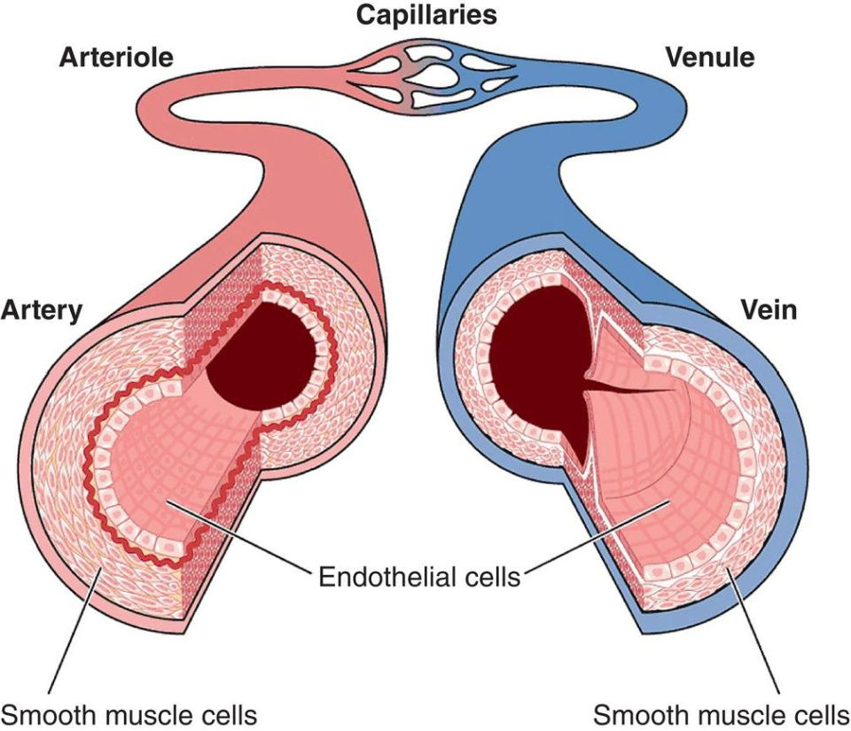
Science
Biological Pathways
  Sedentary Behavior
    Reduced skeletal muscle activity -> impaired glucose uptake -> increased diabetes risk
    Decreased energy/caloric expenditure -> increased BMI (body mass index)
    Poor blood flow due to reduced activity -> endothelial (blood vessel) dysfunction
    Prolonged sitting -> autonomic nervous system imbalance
https://thoracickey.com/14-endothelial-function/
Notes:
Decreased shear stress leads to decreased nitric oxide which leads to endothelial dysfunction
Additionally prolonged sitting can cause inflammation via increased inflammatory markers in the body

Slide 17
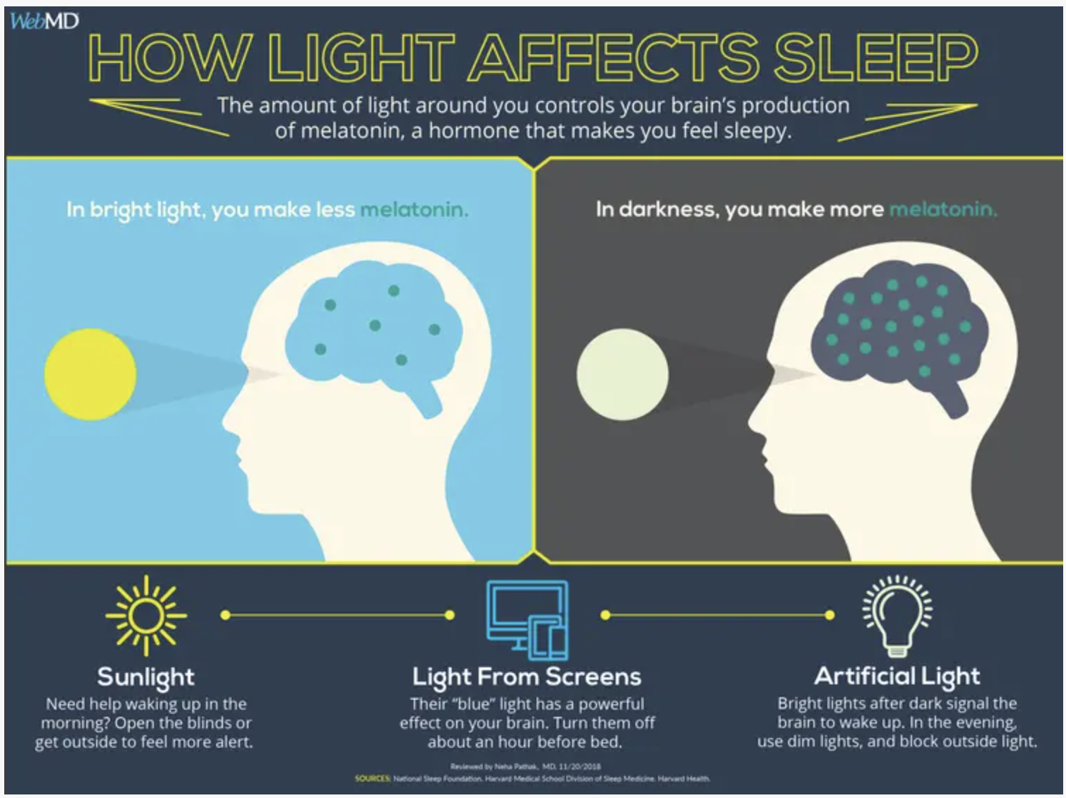
Science
Biological Pathways
  Sleep Disruption
    Blue light suppression of melatonin
    Altered circadian rhythms -> development of higher blood pressures in the morning
    Reduced REM sleep -> negatively impacts metabolic regulation
https://www.webmd.com/sleep-disorders/sleep-blue-light
Notes:
Melatonin (natural hormone which regulates our sleep wake cycle)

Slide 18
Science
Biological Pathways
  Neuroendocrine Stress
    Screen time -> sympathetic nervous system activation due to stimulating content-> cortisol and catecholamine release -> increased resting HR and mild blood pressure elevation

Slide 19
Science
Behavioral and Psychological effects
  Increased caloric intake (snacking, etc)
  Increased stress hormones spurred by anxiety from peer/social interactions
  Reduced desire for physical activity

Slide 20
Interventions
Ways to help
  Practical strategies
  Family and School Based Strategies

Slide 21
Interventions
Ways to help
  Practical strategies
    Goal under 2 hours
    Avoidance of screens 1 hour before bed
    Replace sedentary screen time with activity
Notes:
Aim to reduce recreational screen time to under 2 hours; can take a piece meal approach and gradually reduce over time
Limiting blue light exposure before bedtime can be key to help regulate sleep cycle; can also utilize blue light filters or night mode
Activity includes moderate-vigorous level activity for 30-60+ minutes as well as movement breaks every 30-60 minutes

Slide 22
Interventions
Ways to help
  Family and School Based Strategies
    Parent modeling
    Screen free zones and schedules
    School policies to reduce sedentary time
    Behavioral support structures
Notes:
Can be difficult as older generations also have screen addiction, but modeling positive behaviors can be influential
This is an area of some debate, as some sides argue being without a device during an emergency is dangerous (ie contacting parents) while others argue mass alerts can be sent to parents and otherwise having a device throughout the day or for extended periods of time does more harm
Policies can encourage more periods of activity
Support structures can help manage expectations and desires

Slide 23
Conclusion
Takeaways
  There is not a widely agreed upon consensus when it comes to time, but it is generally accepted that multiple hours per day of recreational screen time is too much
  Increased screen time is associated with a variety of cardiometabolic and cardiovascular risk factors
  There are both practical and group based strategies which if implemented, can serve as a positive solutions

Slide 24
References
Arafa, A., Yasui, Y., Kokubo, Y., Kato, Y., Matsumoto, C., Teramoto, M., ... & Kogirima, M. (2024). Lifestyle behaviors of childhood and adolescence: contributing factors, health consequences, and potential interventions. American Journal of Lifestyle Medicine, 15598276241245941.
Carter, S., Hartman, Y., Holder, S., Thijssen, D. H., & Hopkins, N. D. (2017). Sedentary behavior and cardiovascular disease risk: mediating mechanisms. Exercise and sport sciences reviews, 45(2), 80-86.
Kuzik, N., Da Costa, B. G., Hwang, Y., Verswijveren, S. J., Rollo, S., Tremblay, M. S., ... & Saunders, T. J. (2022). School-related sedentary behaviours and indicators of health and well-being among children and youth: a systematic review. International Journal of Behavioral Nutrition and Physical Activity, 19(1), 40.
Lissak, G. (2018). Adverse physiological and psychological effects of screen time on children and adolescents: Literature review and case study. Environmental research, 164, 149-157.
Magid, H. S. A., Milliren, C. E., Gabriel, K. P., & Nagata, J. M. (2021). Disentangling individual, school, and neighborhood effects on screen time among adolescents and young adults in the United States. Preventive medicine, 142, 106357.
Tremblay, M. S., LeBlanc, A. G., Kho, M. E., Saunders, T. J., Larouche, R., Colley, R. C., ... & Gorber, S. C. (2011). Systematic review of sedentary behaviour and health indicators in school-aged children and youth. International journal of behavioral nutrition and physical activity, 8(1), 98.
Zablotsky, B., Arockiaraj, B., Haile, G., & Ng, A. E. (2024). Daily Screen Time Among Teenagers: United States, July 2021–December 2023.
Zablotsky, B., Ng, A. E., Black, L. I., Haile, G., Bose, J., Jones, J. R., & Blumberg, S. J. (2025). Associations Between Screen Time Use and Health Outcomes Among US Teenagers. Preventing Chronic Disease, 22, E38.

Slide 25
Questions?

